Slide 1


Example-Driven Query Intent Discovery: Abductive Reasoning using Semantic Similarity
Anna Fariha
Alexandra Meliou
College of Information and Computer Sciences
University of Massachusetts Amherst

Slide 2





Are databases accessible to non-experts?
Who are our most valuable customers?

Slide 3
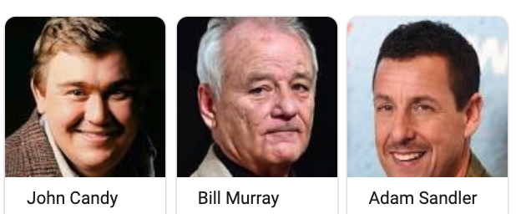

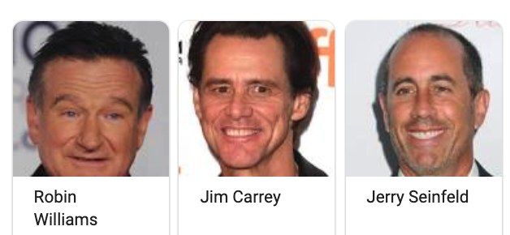
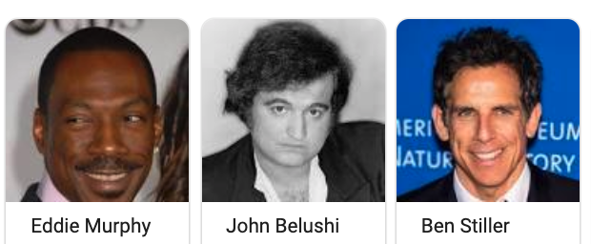
Alice wants to find all Funny Actors from the IMDb database.

Slide 4
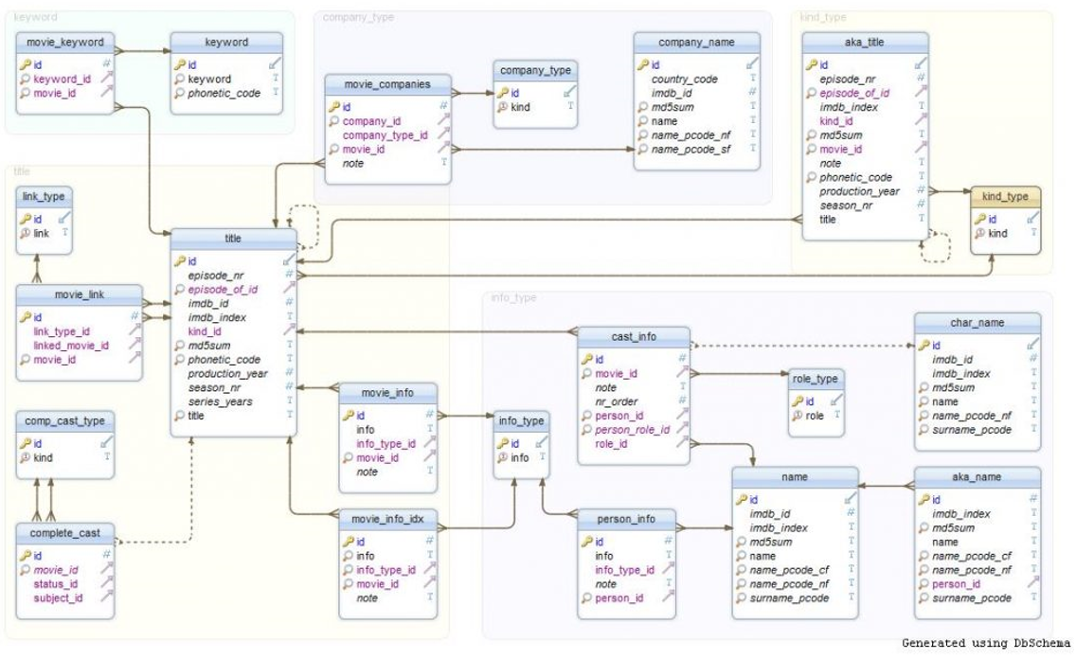

Challenge 1: understanding the schema

Slide 5
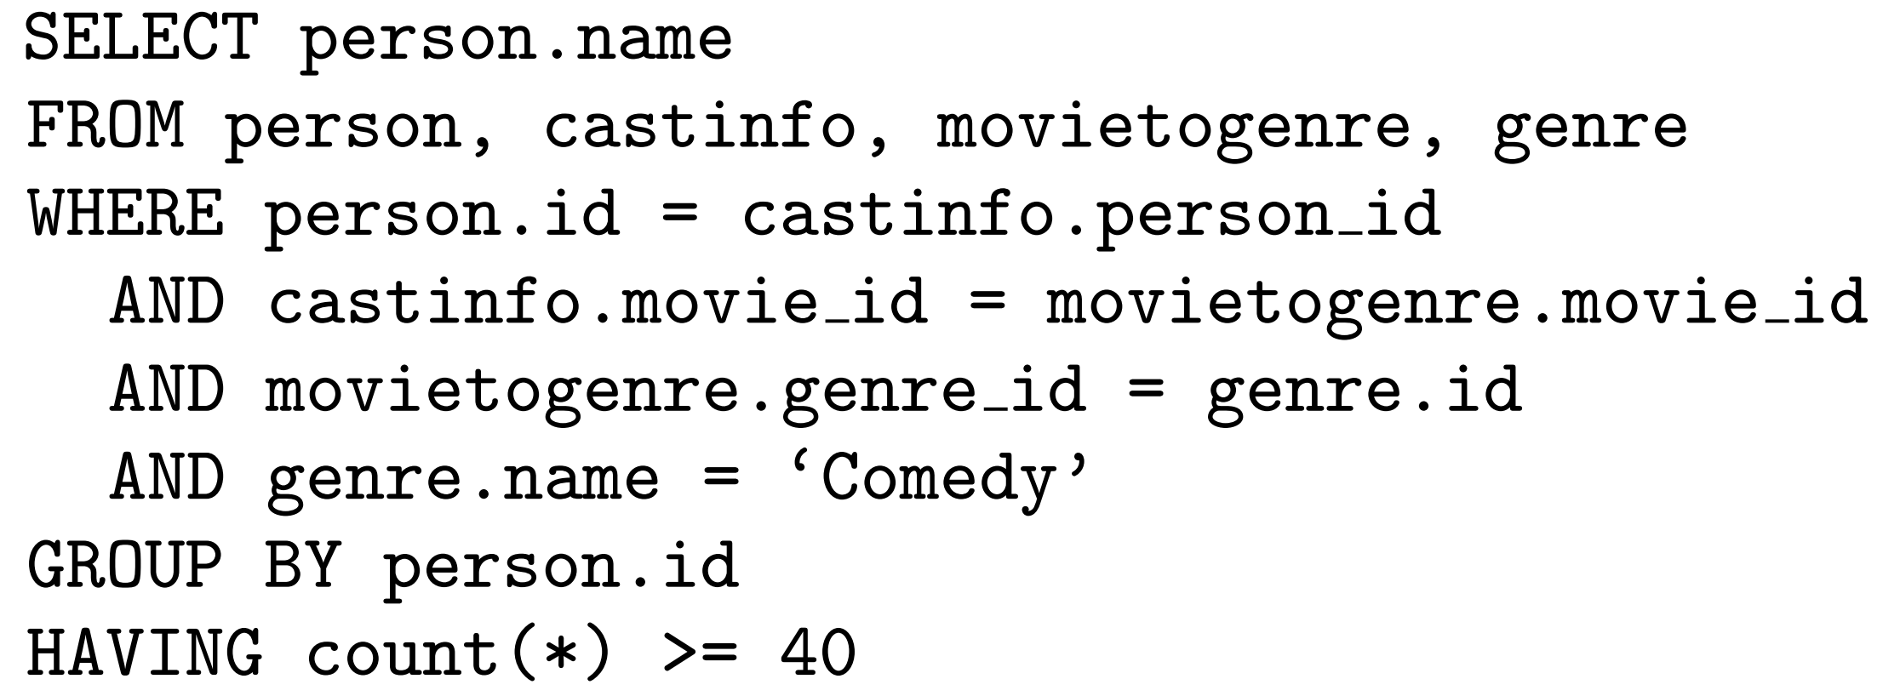
Challenge 2: SQL expertise

Slide 6
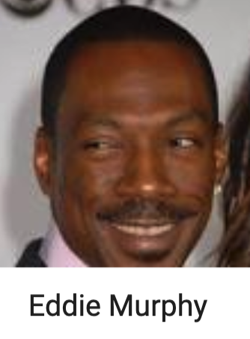
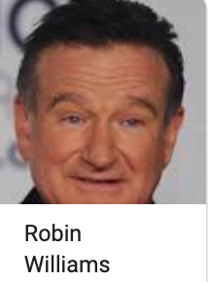
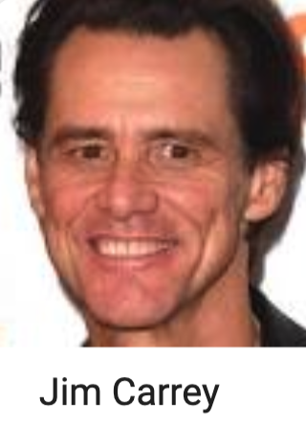
Query by example
QBE

Slide 7
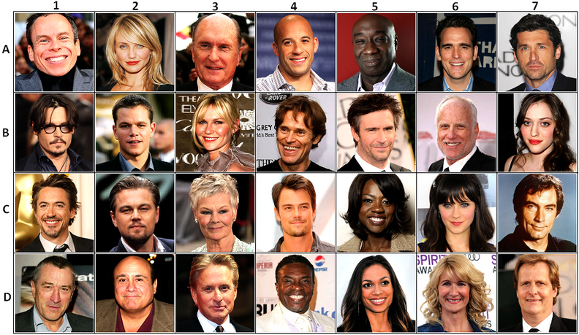
Expectation vs reality
All actors

Slide 8

Humans use context

Slide 9



Discovering semantic similarity
Comedy
Comedy
Comedy
Comedy
Comedy
Comedy
There is no “funny” attribute in the data
Comedy
Comedy
Comedy
Comedy
Comedy
Comedy
Comedy
Comedy
Comedy
Comedy
Comedy
Comedy

Slide 10
Query by example
Knowledge Graph
QBE
limited
context
QRE
learning
active learning
Query
Reverse
Engineering
requires all output
overfits
too many examples
too much interaction

Slide 11
SQuID Semantic similarity-aware Query Intent Discovery

Slide 12
What’s coming
Modeling Semantic Context
Query Intent Discovery
Real-time Performance
Evaluation

Slide 13
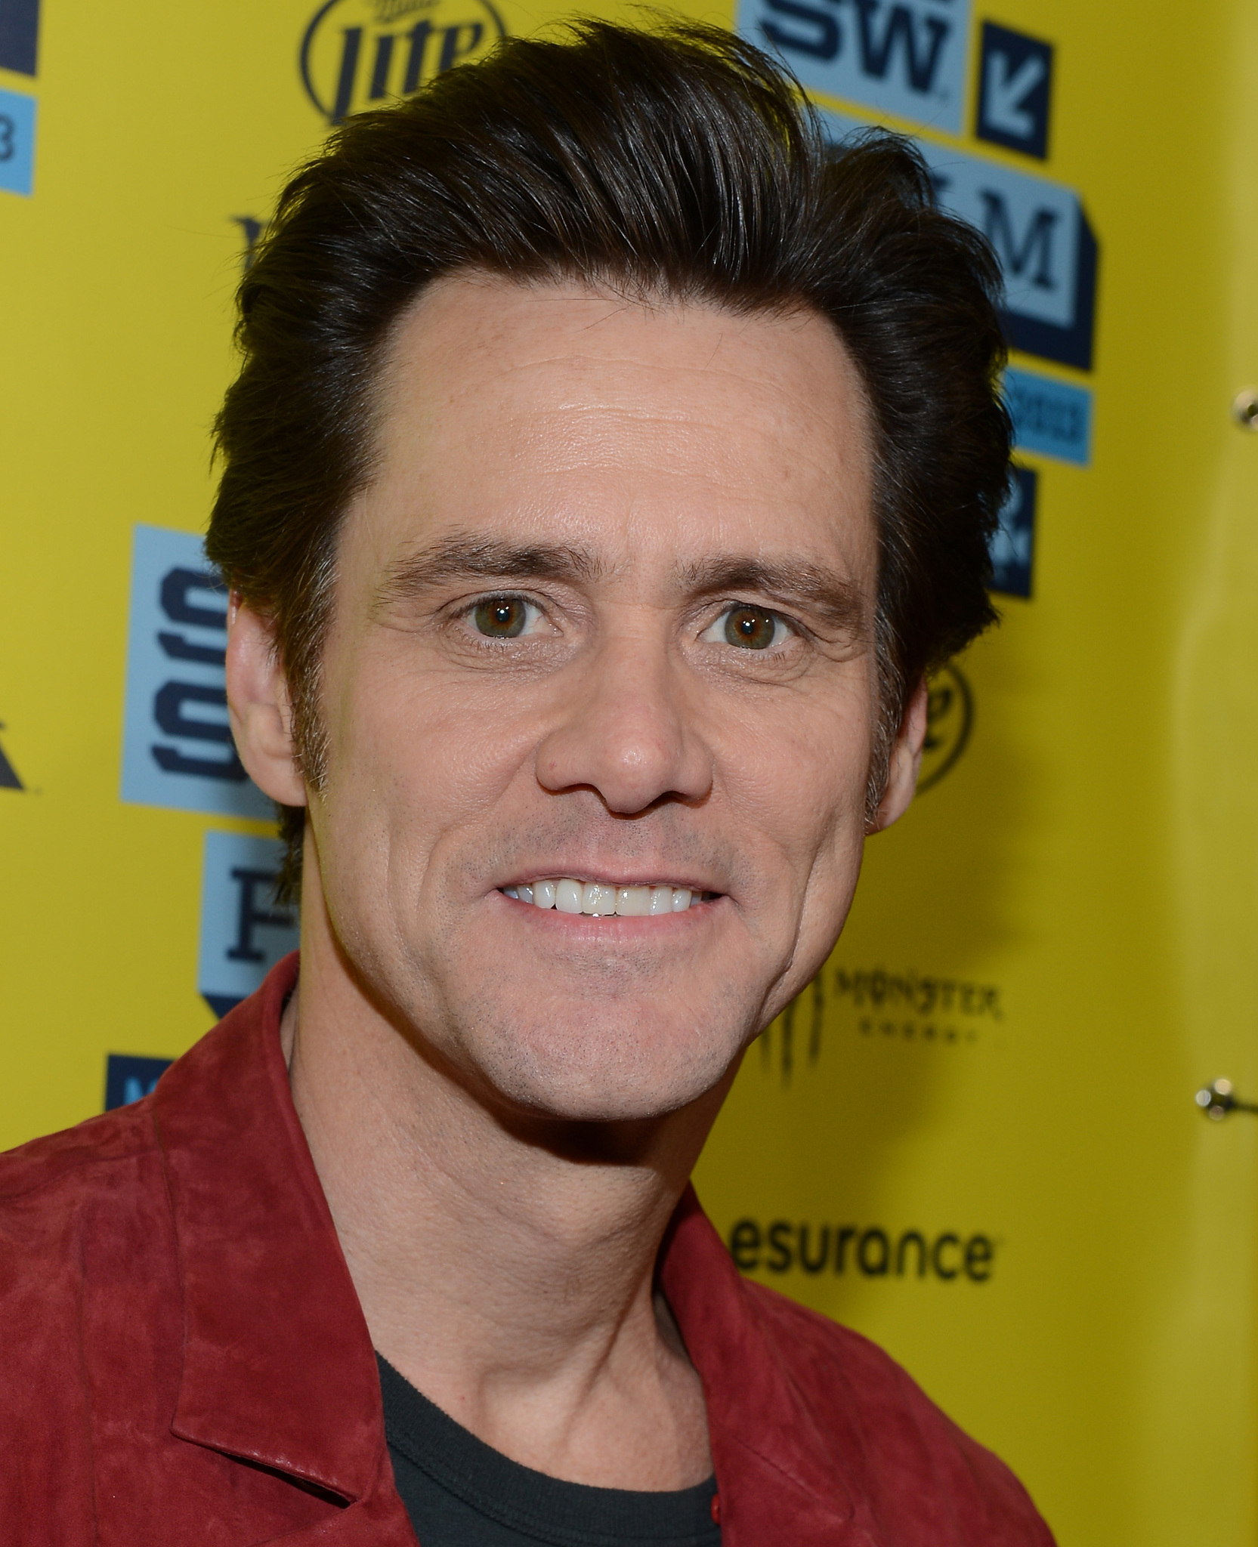
Semantic context: basic
Modeling Semantic Context
Query Intent Discovery
Real-time Performance
Evaluation
Directly affiliated with an entity.
birth year
1962
gender
Male
person
height
6’ 2’’
age
57

Slide 14
Semantic context: derived
Modeling Semantic Context
Query Intent Discovery
Real-time Performance
Evaluation
Aggregate over a basic property of an associated entity.
number of comedy movies an actor appeared in.
40 Comedy movies
genre
10 Drama movies
person
movie
language
67 English movies

Slide 15

Filters
Modeling Semantic Context
Query Intent Discovery
Real-time Performance
Evaluation
Encode semantic context.
SELECT
person
FROM
people
WHERE
color = orange

Slide 16
Intended or co-incidental?
Modeling Semantic Context
Query Intent Discovery
Real-time Performance
Evaluation
Male
Born in North America
Appeared in 80+ Hollywood movies
Appeared in 40+ comedy movies
Appeared in 20+ drama movies
Height above 5 feet
Born after 1940
…

Slide 17
Abduction
Modeling Semantic Context
Query Intent Discovery
Real-time Performance
Evaluation
Most likely explanation of an observation.
Most likely query given the examples.
Maximum likelihood estimation is abduction!

Slide 18
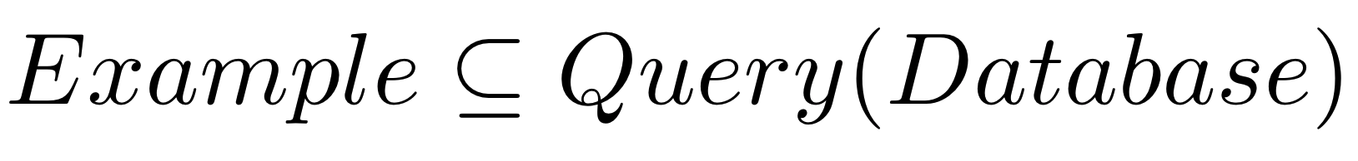
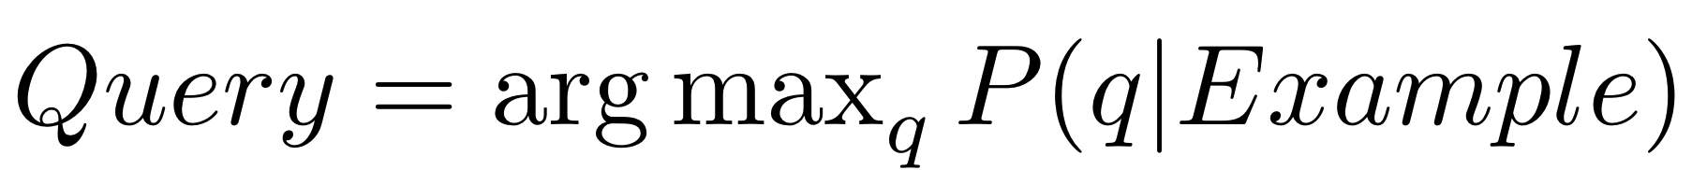
Problem definition
Modeling Semantic Context
Query Intent Discovery
Real-time Performance
Evaluation
Query intent discovery: given a Database and Example, find Query such that:

Slide 19
Probabilistic abduction model
Modeling Semantic Context
Query Intent Discovery
Real-time Performance
Evaluation
semantic context posterior
query prior
query posterior
semantic context prior

Slide 20
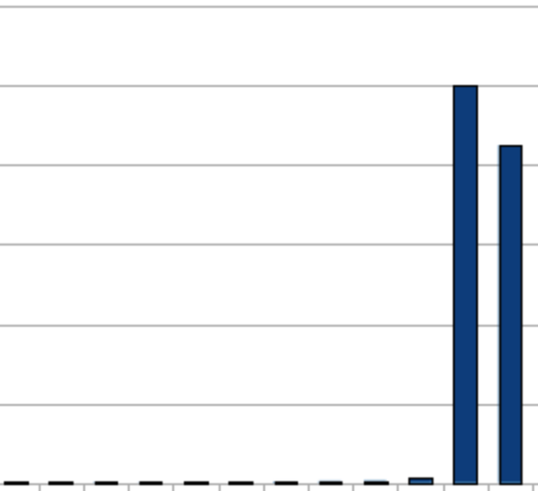



Modeling Semantic Context
Query Intent Discovery
Real-time Performance
Evaluation
Domain selectivity
Association strength
Outlier
SELECT * FROM p
WHERE 25 <= age <= 30
25 30
age
0 5 90 100
SELECT * FROM p
WHERE 5 <= age <= 90

Slide 21
Modeling Semantic Context
Query Intent Discovery
Real-time Performance
Evaluation
Data selectivity
 | country
… | USA
… | USA
… | USA
… | USA
… | USA
… | CAN
… | USA
… | CAN
… | USA
… | USA
USA: 80%
CAN: 20%

Slide 22
Modeling Semantic Context
Query Intent Discovery
Real-time Performance
Evaluation
Context
Predicate in Query
 | country
… | USA
… | USA
… | USA
… | USA
… | USA
… | CAN
… | USA
… | CAN
… | USA
… | USA
 | country
… | USA
… | USA
 | country
… | USA
 | country
… | USA
… | USA
… | USA
 | country
… | USA
… | USA
… | USA
P(USA| country = USA)
= 1
P(USA | No Filter)
= 0.8
P(USA | No Filter)
= 0.8 * 0.8
= 0.64
P(USA | No Filter)
= 0.8 * 0.8 * 0.8
= 0.51

Slide 23

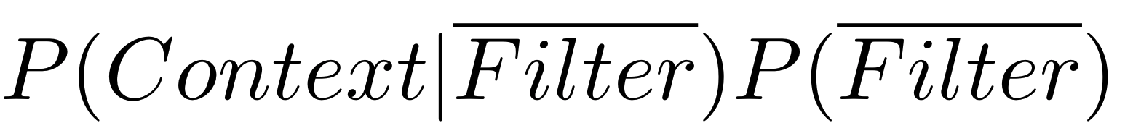
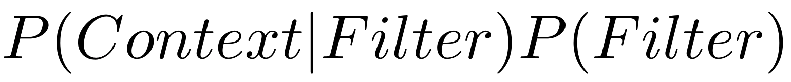
SQuID algorithm
Modeling Semantic Context
Query Intent Discovery
Real-time Performance
Evaluation
Filters: to pick or drop?
Without filter
With filter

Slide 24

Real-time performance
Modeling Semantic Context
Query Intent Discovery
Real-time
Evaluation

Slide 25
Abduction-ready database
Modeling Semantic Context
Query Intent Discovery
Real-time
Evaluation

Slide 26
How well does SQuID do in practice?

Slide 27
Modeling Semantic Context
Query Intent Discovery
Real-time Performance
Evaluation
How efficient is SQuID for large datasets and many examples?
Does SQuID infer the right query?
Can alternative techniques be effective in intent discovery?
Query Reverse Engineering (TALOS, 2014)
Positive and Unlabeled Learning (Elkan et al., 2008)
Query run-time comparison [In the paper]
Case studies [In the paper]

Slide 28



Datasets
Modeling Semantic Context
Query Intent Discovery
Real-time Performance
Evaluation
[In the paper]
633 MB
15 relations
person: 6M rows
movies: 1M rows
castinfo: 14M rows
5 benchmark queries
20 benchmark queries
16 benchmark queries

Slide 29

Experiment Settings
Modeling Semantic Context
Query Intent Discovery
Real-time Performance
Evaluation
Inferred Query
Result
Sample
SQuID Result
Example
Benchmark Query
Compare
Ground Truth

Slide 30
How does SQuID perform with large datasets or many examples?
Modeling Semantic Context
Query Intent Discovery
Real-time Performance
Evaluation
Abduction time is practical
Logarithmic
in DB size
Linear in example size

Slide 31
SQuID works with few examples
Modeling Semantic Context
Query Intent Discovery
Real-time Performance
Evaluation
Indian actors who acted in
at least 15 Hollywood movies

Slide 32
Query Reverse Engineering
Modeling Semantic Context
Query Intent Discovery
Real-time Performance
Evaluation
Input
Output
QRE
TALOS
Reverse Engineered Query
Exact match required

Slide 33
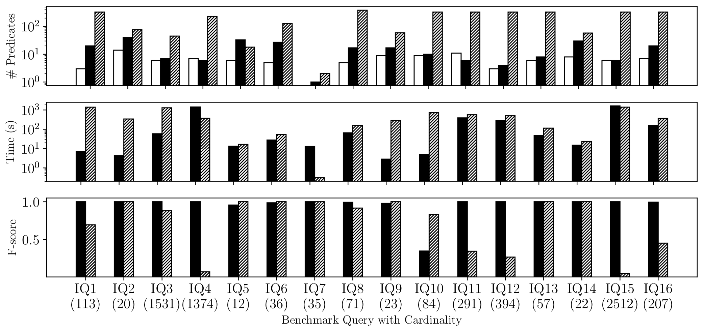
SQuID outperforms Query Reverse Engineering (TALOS)
Modeling Semantic Context
Query Intent Discovery
Real-time Performance
Evaluation
Log scale
Log scale

Slide 34
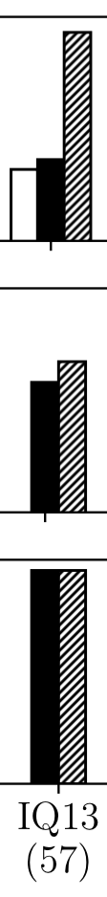
SQuID outperforms Query Reverse Engineering (TALOS)
Modeling Semantic Context
Query Intent Discovery
Real-time Performance
Evaluation
SELECT
DISTINCT movie.title
FROM
movie, production, company, movietogenre, genre
WHERE
movie.production_year >= 1984 AND
movie.production_year <= 2021 AND movie.country = USA AND
genre.name = 'Animation' AND company.name = 'Pixar' AND
movie.id = movietogenre.movie_id AND
genre.id = movietogenre.genre_id AND
movie.id = movietoproduction.movie_id AND
company.id = movietoproduction.company_id
Original Query
SELECT
DISTINCT movie.title
FROM
movie, production, company, movietogenre, genre
WHERE
movie.id = production.movie_id AND
production.company_id = company.id AND
company.name LIKE '%Pixar%' AND
movie.id = movietogenre.movie_id AND
movietogenre.genre_id = genre.id AND
genre.name = 'Animation';
TALOS Query
SELECT
distinct title
FROM
movie
WHERE
((movie.title='Inside Out' OR movie.title='Lifted' OR movie.title='Lou' OR movie.title='For the Birds' OR movie.title='Brave' OR movie.title='Coco')) OR ((movie.title<>'Inside Out' AND movie.title<>'Lifted' AND movie.title<>'Lou' AND movie.title<>'For the Birds' AND movie.title<>'Brave' AND movie.title<>'Coco') AND (movie.title='A Bug"s Life' OR movie.title='André and Wally B.' OR movie.title='Boundin"' OR movie.title='Burn-E' OR movie.title='Cars 2' OR movie.title='Cars 3')) OR ((movie.title<>'Inside Out' AND movie.title<>'Lifted' AND movie.title<>'Lou' AND movie.title<>'For the Birds' AND movie.title<>'Brave' AND movie.title<>'Coco') AND (movie.title<>'A Bug"s Life' AND movie.title<>'André and Wally B.' AND movie.title<>'Boundin"' AND movie.title<>'Burn-E' AND movie.title<>'Cars 2' AND movie.title<>'Cars 3') AND (movie.title='Dante"s Lunch: A Short Tail' OR movie.title='Finding Dory' OR movie.title='Finding Nemo' OR movie.title='Geri"s Game' OR movie.title='Hawaiian Vacation' OR movie.title='It"s Tough to Be a Bug')) OR ((movie.title<>'Inside Out' AND movie.title<>'Lifted' AND movie.title<>'Lou' AND movie.title<>'For the Birds' AND movie.title<>'Brave' AND movie.title<>'Coco') AND (movie.title<>'A Bug"s Life' AND movie.title<>'André and Wally B.' AND movie.title<>'Boundin"' AND movie.title<>'Burn-E' AND movie.title<>'Cars 2' AND movie.title<>'Cars 3') AND (movie.title<>'Dante"s Lunch: A Short Tail' AND movie.title<>'Finding Dory' AND movie.title<>'Finding Nemo' AND movie.title<>'Geri"s Game' AND movie.title<>'Hawaiian Vacation' AND movie.title<>'It"s Tough to Be a Bug') AND (movie.title='Knick Knack' OR movie.title='Luxo Jr.' OR movie.title='Luxo Jr. in "Surprise" and "Light & Heavy"' OR movie.title='Luxo Jr. in "Up and Down"' OR movie.title='Monsters University' OR movie.title='Monsters, Inc.')) OR ((movie.title<>'Inside Out' AND movie.title<>'Lifted' AND movie.title<>'Lou' AND movie.title<>'For the Birds' AND movie.title<>'Brave' AND movie.title<>'Coco') AND (movie.title<>'A Bug"s Life' AND movie.title<>'André and Wally B.' AND movie.title<>'Boundin"' AND movie.title<>'Burn-E' AND movie.title<>'Cars 2' AND movie.title<>'Cars 3') AND (movie.title<>'Dante"s Lunch: A Short Tail' AND movie.title<>'Finding Dory' AND movie.title<>'Finding Nemo' AND movie.title<>'Geri"s Game' AND movie.title<>'Hawaiian Vacation' AND movie.title<>'It"s Tough to Be a Bug') AND (movie.title<>'Knick Knack' AND movie.title<>'Luxo Jr.' AND movie.title<>'Luxo Jr. in "Surprise" and "Light & Heavy"' AND movie.title<>'Luxo Jr. in "Up and Down"' AND movie.title<>'Monsters University' AND movie.title<>'Monsters, Inc.') AND (movie.title='Party Central' OR movie.title='Partysaurus Rex' OR movie.title='Red"s Dream' OR movie.title='Riley"s First Date?' OR movie.title='Sanjay"s Super Team' OR movie.title='The Good Dinosaur')) OR ((movie.title<>'Inside Out' AND movie.title<>'Lifted' AND movie.title<>'Lou' AND movie.title<>'For the Birds' AND movie.title<>'Brave' AND movie.title<>'Coco') AND (movie.title<>'A Bug"s Life' AND movie.title<>'André and Wally B.' AND movie.title<>'Boundin"' AND movie.title<>'Burn-E' AND movie.title<>'Cars 2' AND movie.title<>'Cars 3') AND (movie.title<>'Dante"s Lunch: A Short Tail' AND movie.title<>'Finding Dory' AND movie.title<>'Finding Nemo' AND movie.title<>'Geri"s Game' AND movie.title<>'Hawaiian Vacation' AND movie.title<>'It"s Tough to Be a Bug') AND (movie.title<>'Knick Knack' AND movie.title<>'Luxo Jr.' AND movie.title<>'Luxo Jr. in "Surprise" and "Light & Heavy"' AND movie.title<>'Luxo Jr. in "Up and Down"' AND movie.title<>'Monsters University' AND movie.title<>'Monsters, Inc.') AND (movie.title<>'Party Central' AND movie.title<>'Partysaurus Rex' AND movie.title<>'Red"s Dream' AND movie.title<>'Riley"s First Date?' AND movie.title<>'Sanjay"s Super Team' AND movie.title<>'The Good Dinosaur') AND (movie.title='The Incredibles' OR movie.title='The Incredibles 2' OR movie.title='Tin Toy' OR movie.title='Tokyo Mater' OR movie.title='Toy Story' OR movie.title='Toy Story 2')) OR ((movie.title<>'Inside Out' AND movie.title<>'Lifted' AND movie.title<>'Lou' AND movie.title<>'For the Birds' AND movie.title<>'Brave' AND movie.title<>'Coco') AND (movie.title<>'A Bug"s Life' AND movie.title<>'André and Wally B.' AND movie.title<>'Boundin"' AND movie.title<>'Burn-E' AND movie.title<>'Cars 2' AND movie.title<>'Cars 3') AND (movie.title<>'Dante"s Lunch: A Short Tail' AND movie.title<>'Finding Dory' AND movie.title<>'Finding Nemo' AND movie.title<>'Geri"s Game' AND movie.title<>'Hawaiian Vacation' AND movie.title<>'It"s Tough to Be a Bug') AND (movie.title<>'Knick Knack' AND movie.title<>'Luxo Jr.' AND movie.title<>'Luxo Jr. in "Surprise" and "Light & Heavy"' AND movie.title<>'Luxo Jr. in "Up and Down"' AND movie.title<>'Monsters University' AND movie.title<>'Monsters, Inc.') AND (movie.title<>'Party Central' AND movie.title<>'Partysaurus Rex' AND movie.title<>'Red"s Dream' AND movie.title<>'Riley"s First Date?' AND movie.title<>'Sanjay"s Super Team' AND movie.title<>'The Good Dinosaur') AND (movie.title<>'The Incredibles' AND movie.title<>'The Incredibles 2' AND movie.title<>'Tin Toy' AND movie.title<>'Tokyo Mater' AND movie.title<>'Toy Story' AND movie.title<>'Toy Story 2') AND (movie.title='Toy Story 3' OR movie.title='Toy Story 4' OR movie.title='Untitled Pixar Animation Project' OR movie.title='WALL·E' OR movie.title='Your Friend the Rat' OR movie.title='Cars') AND movie.production_year>2006) OR ((movie.title<>'Inside Out' AND movie.title<>'Lifted' AND movie.title<>'Lou' AND movie.title<>'For the Birds' AND movie.title<>'Brave' AND movie.title<>'Coco') AND (movie.title<>'A Bug"s Life' AND movie.title<>'André and Wally B.' AND movie.title<>'Boundin"' AND movie.title<>'Burn-E' AND movie.title<>'Cars 2' AND movie.title<>'Cars 3') AND (movie.title<>'Dante"s Lunch: A Short Tail' AND movie.title<>'Finding Dory' AND movie.title<>'Finding Nemo' AND movie.title<>'Geri"s Game' AND movie.title<>'Hawaiian Vacation' AND movie.title<>'It"s Tough to Be a Bug') AND (movie.title<>'Knick Knack' AND movie.title<>'Luxo Jr.' AND movie.title<>'Luxo Jr. in "Surprise" and "Light & Heavy"' AND movie.title<>'Luxo Jr. in "Up and Down"' AND movie.title<>'Monsters University' AND movie.title<>'Monsters, Inc.') AND (movie.title<>'Party Central' AND movie.title<>'Partysaurus Rex' AND movie.title<>'Red"s Dream' AND movie.title<>'Riley"s First Date?' AND movie.title<>'Sanjay"s Super Team' AND movie.title<>'The Good Dinosaur') AND (movie.title<>'The Incredibles' AND movie.title<>'The Incredibles 2' AND movie.title<>'Tin Toy' AND movie.title<>'Tokyo Mater' AND movie.title<>'Toy Story' AND movie.title<>'Toy Story 2') AND (movie.title<>'Toy Story 3' AND movie.title<>'Toy Story 4' AND movie.title<>'Untitled Pixar Animation Project' AND movie.title<>'WALL·E' AND movie.title<>'Your Friend the Rat' AND movie.title<>'Cars') AND (movie.title='La Luna' OR movie.title='Ratatouille' OR movie.title='The Blue Umbrella' OR movie.title='One Man Band' OR movie.title='Presto' OR movie.title='Small Fry') AND movie.production_year<=2008 AND movie.production_year<=1965) OR ((movie.title<>'Inside Out' AND movie.title<>'Lifted' AND movie.title<>'Lou' AND movie.title<>'For the Birds' AND movie.title<>'Brave' AND movie.title<>'Coco') AND (movie.title<>'A Bug"s Life' AND movie.title<>'André and Wally B.' AND movie.title<>'Boundin"' AND movie.title<>'Burn-E' AND movie.title<>'Cars 2' AND movie.title<>'Cars 3') AND (movie.title<>'Dante"s Lunch: A Short Tail' AND movie.title<>'Finding Dory' AND movie.title<>'Finding Nemo' AND movie.title<>'Geri"s Game' AND movie.title<>'Hawaiian Vacation' AND movie.title<>'It"s Tough to Be a Bug') AND (movie.title<>'Knick Knack' AND movie.title<>'Luxo Jr.' AND movie.title<>'Luxo Jr. in "Surprise" and "Light & Heavy"' AND movie.title<>'Luxo Jr. in "Up and Down"' AND movie.title<>'Monsters University' AND movie.title<>'Monsters, Inc.') AND (movie.title<>'Party Central' AND movie.title<>'Partysaurus Rex' AND movie.title<>'Red"s Dream' AND movie.title<>'Riley"s First Date?' AND movie.title<>'Sanjay"s Super Team' AND movie.title<>'The Good Dinosaur') AND (movie.title<>'The Incredibles' AND movie.title<>'The Incredibles 2' AND movie.title<>'Tin Toy' AND movie.title<>'Tokyo Mater' AND movie.title<>'Toy Story' AND movie.title<>'Toy Story 2') AND (movie.title<>'Toy Story 3' AND movie.title<>'Toy Story 4' AND movie.title<>'Untitled Pixar Animation Project' AND movie.title<>'WALL·E' AND movie.title<>'Your Friend the Rat' AND movie.title<>'Cars') AND (movie.title='La Luna' OR movie.title='Ratatouille' OR movie.title='The Blue Umbrella' OR movie.title='One Man Band' OR movie.title='Presto' OR movie.title='Small Fry') AND movie.production_year<=2008 AND movie.production_year>1965) OR ((movie.title<>'Inside Out' AND movie.title<>'Lifted' AND movie.title<>'Lou' AND movie.title<>'For the Birds' AND movie.title<>'Brave' AND movie.title<>'Coco') AND (movie.title<>'A Bug"s Life' AND movie.title<>'André and Wally B.' AND movie.title<>'Boundin"' AND movie.title<>'Burn-E' AND movie.title<>'Cars 2' AND movie.title<>'Cars 3') AND (movie.title<>'Dante"s Lunch: A Short Tail' AND movie.title<>'Finding Dory' AND movie.title<>'Finding Nemo' AND movie.title<>'Geri"s Game' AND movie.title<>'Hawaiian Vacation' AND movie.title<>'It"s Tough to Be a Bug') AND (movie.title<>'Knick Knack' AND movie.title<>'Luxo Jr.' AND movie.title<>'Luxo Jr. in "Surprise" and "Light & Heavy"' AND movie.title<>'Luxo Jr. in "Up and Down"' AND movie.title<>'Monsters University' AND movie.title<>'Monsters, Inc.') AND (movie.title<>'Party Central' AND movie.title<>'Partysaurus Rex' AND movie.title<>'Red"s Dream' AND movie.title<>'Riley"s First Date?' AND movie.title<>'Sanjay"s Super Team' AND movie.title<>'The Good Dinosaur') AND (movie.title<>'The Incredibles' AND movie.title<>'The Incredibles 2' AND movie.title<>'Tin Toy' AND movie.title<>'Tokyo Mater' AND movie.title<>'Toy Story' AND movie.title<>'Toy Story 2') AND (movie.title<>'Toy Story 3' AND movie.title<>'Toy Story 4' AND movie.title<>'Untitled Pixar Animation Project' AND movie.title<>'WALL·E' AND movie.title<>'Your Friend the Rat' AND movie.title<>'Cars') AND (movie.title<>'La Luna' AND movie.title<>'Ratatouille' AND movie.title<>'The Blue Umbrella' AND movie.title<>'One Man Band' AND movie.title<>'Presto' AND movie.title<>'Small Fry') AND (movie.title='Day & Night' OR movie.title='Partly Cloudy' OR movie.title='Piper' OR movie.title='Lava' OR movie.title='Up') AND movie.production_year<=1984)
Query Reverse Engineering
over fits
Animation movies produced by Pixar
Notes:
So let’s take a look at this query. The task was to find all Animation movies by Pixar.
This was the original query,
This is what SQuID inferred, with a few more predicates than the original. This is because it wasn’t able to figure out that some similarities were just co-incidental, and not intended.
But this is what TALOS produced.
Query reverse engineering approaches basically OVERFITS to the output as it tries to reconstruct a query that produces this exact same result. But it fails to generalize the intent.

Slide 35
SQuID outperforms Positive & Unlabeled (PU) learning
Modeling Semantic Context
Query Intent Discovery
Real-time Performance
Evaluation
PU learning does not scale
PU learning requires >= 70% data as example
Generic machine learning cannot model RDBMS specific assumptions

Slide 36
Takeaways
Works with very few examples
Exploits
semantic similarity
of the examples
Performs well in
Query Reverse Engineering
setting
Understands context
Outperforms
learning methods
squid.cs.umass.edu

Slide 37
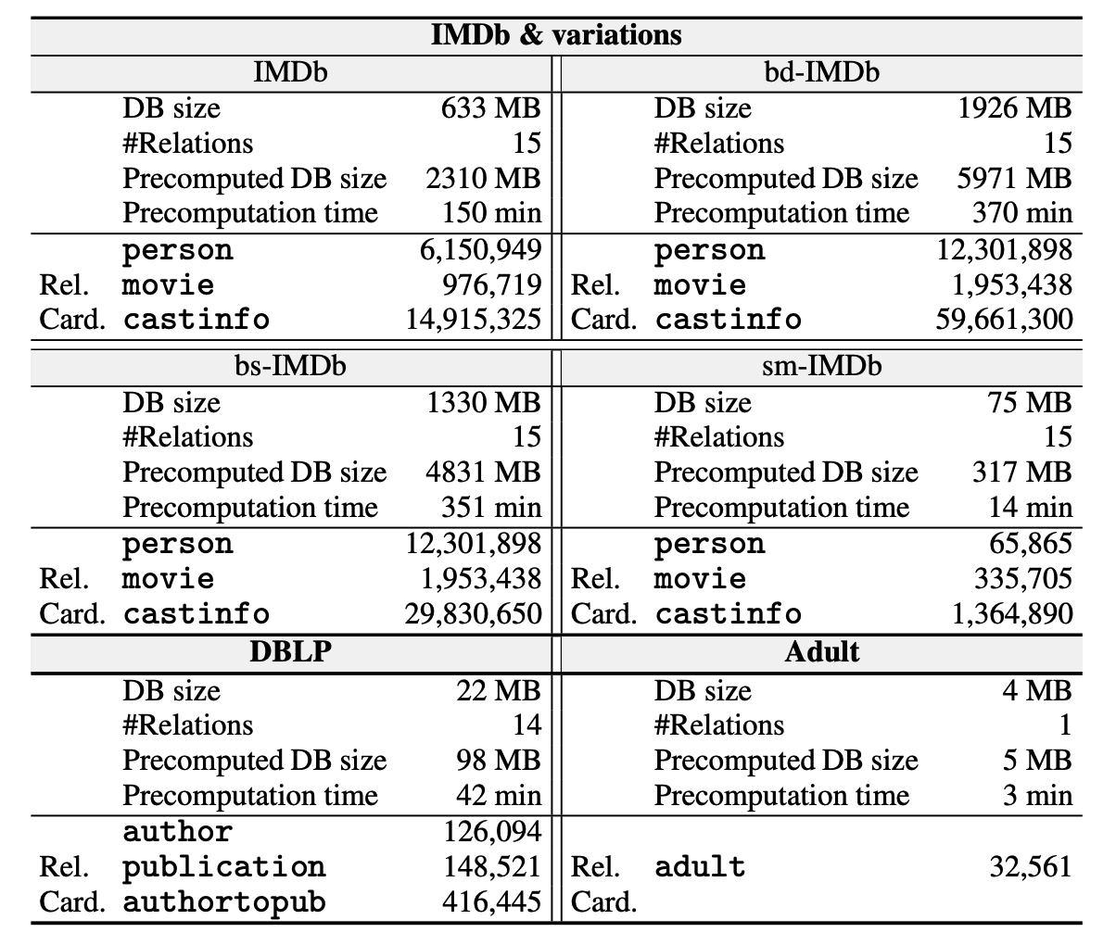
Offline precomputation

Slide 38
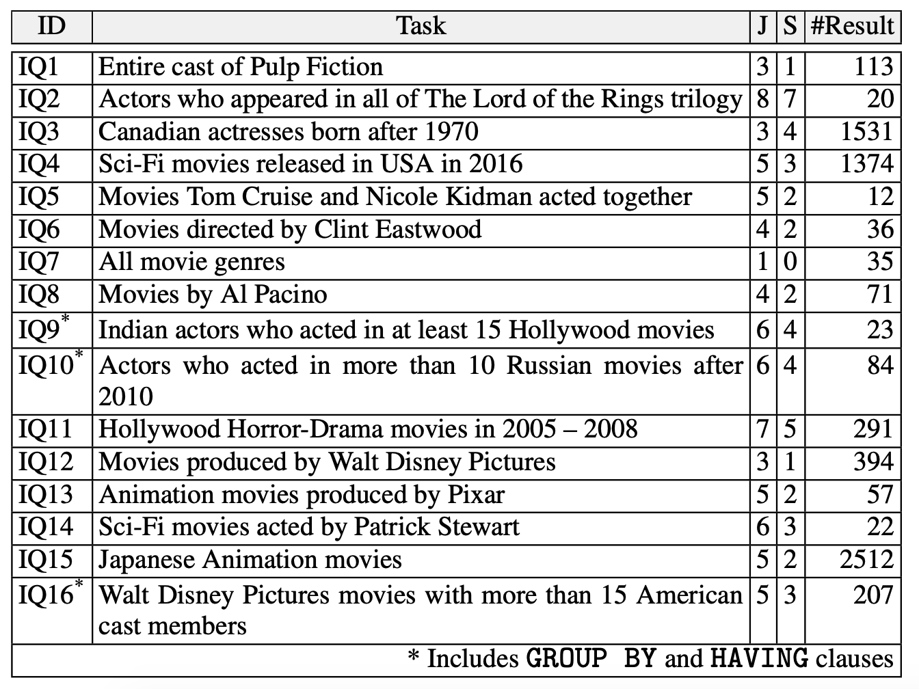
Benchmark queries

Slide 39
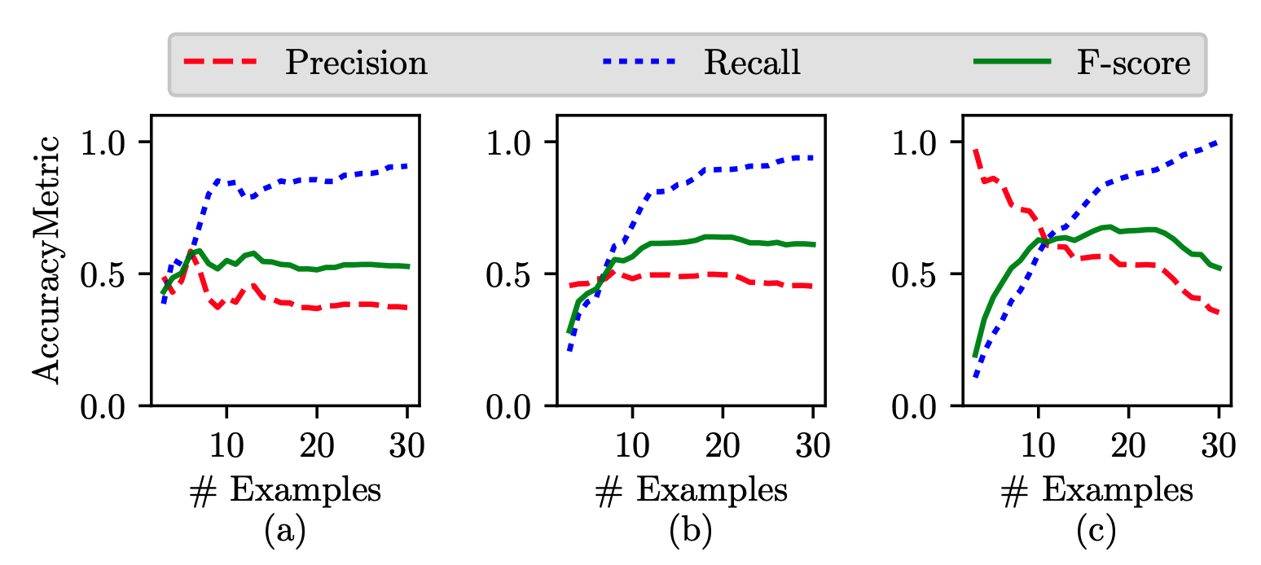
Case studies

Slide 40
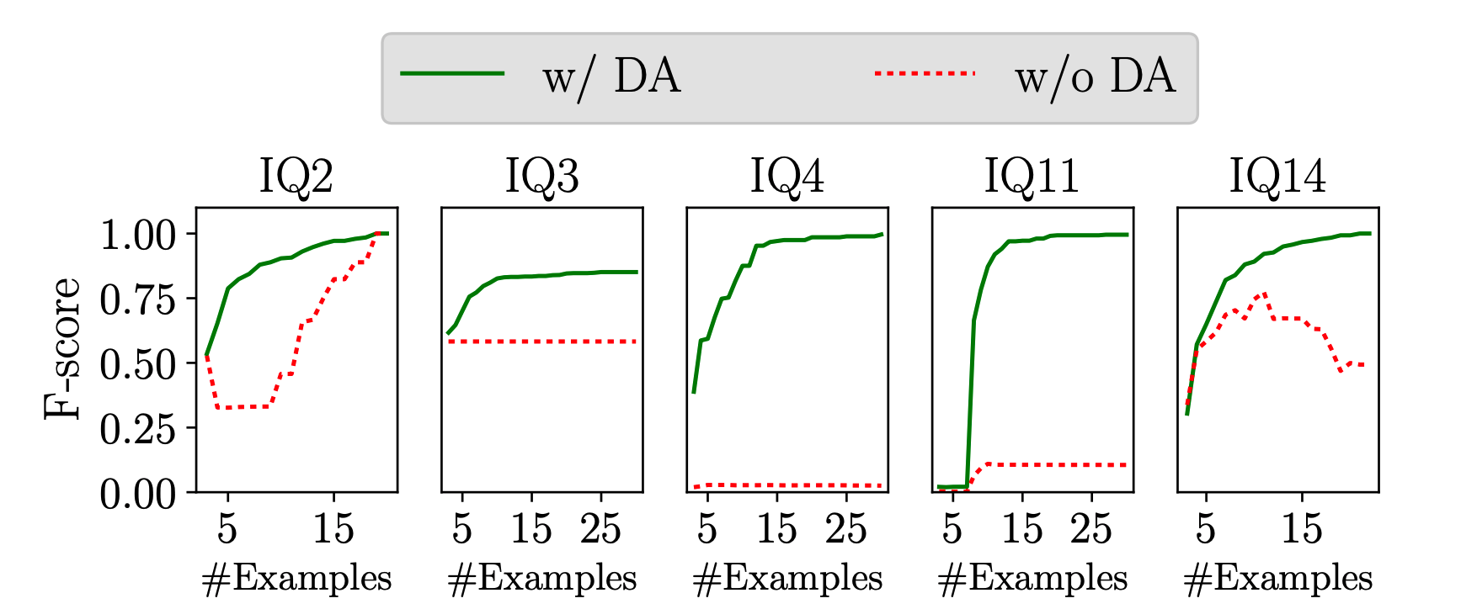
Disambiguation

Slide 41
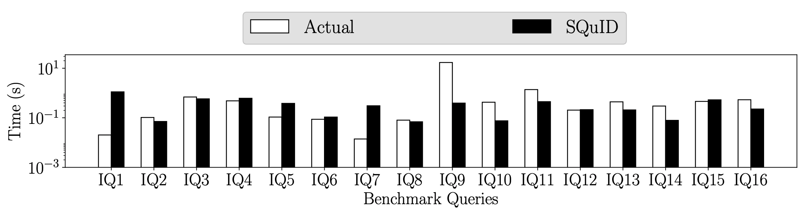
SQuID query vs actual query

Slide 42
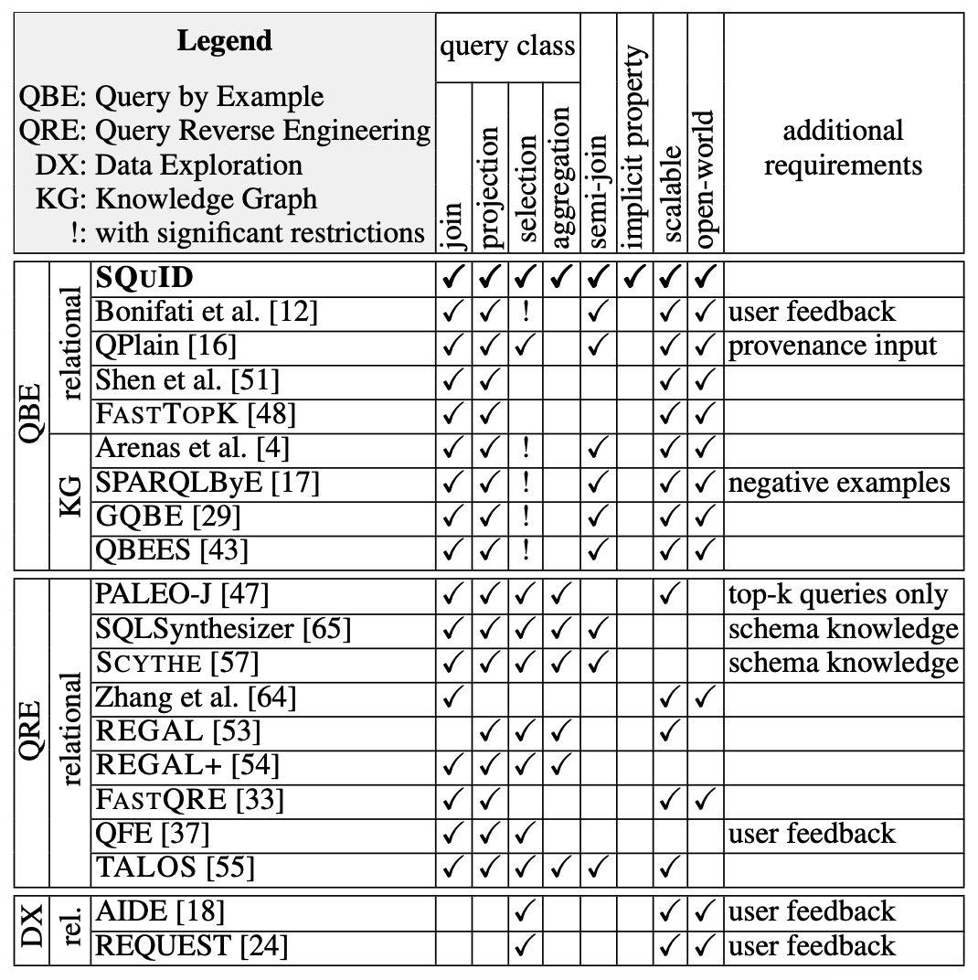
Related work

